Slide 1
Annual Training 2023
Introduction to Standardized Recipes
Catholic Charities Child Care Nutrition Program

Slide 2
How often do you hear, “This looks different than last time!” or “This doesn’t taste the same as it usually does!”? Using standardized recipes can help to ensure your recipe turns out the same way each time you make it. It is a good practice to use a standardized recipe when a menu item has two or more components that are mixed together. If the components are separate, no recipe is needed. For example, if we arrive and you are serving spaghetti and the pasta, tomato sauce and meat are in separate dishes, no recipe is needed because we can see each separate component being served to each child.
What Is a Standardized Recipe?
A standardized recipe is one that has been tried, adapted, and retried for use in a foodservice operation and is shown to produce the same high-quality product and yield every time. A standardized recipe in the CACFP shows that the menu item meets the meal pattern requirements.
Standardized Recipes

Slide 3
When writing your standardized recipe, the only sections we will be looking for is the title, the average number of children you have in a given week for each age group, the components in the recipe, and the total serving size for each component. There is no need to write the directions for how to prepare the food. You will also need the meal pattern reference sheet.
We have developed a simplified recipe worksheet for you to use in the following slide. We will mail out folders with protective sheet covers and several copies of the recipe worksheet to help you get started on writing your recipes. We will also mail out an updated copy of the CACFP meal pattern reference sheet.
What Do You Need For A Standardized Recipe?

Slide 4
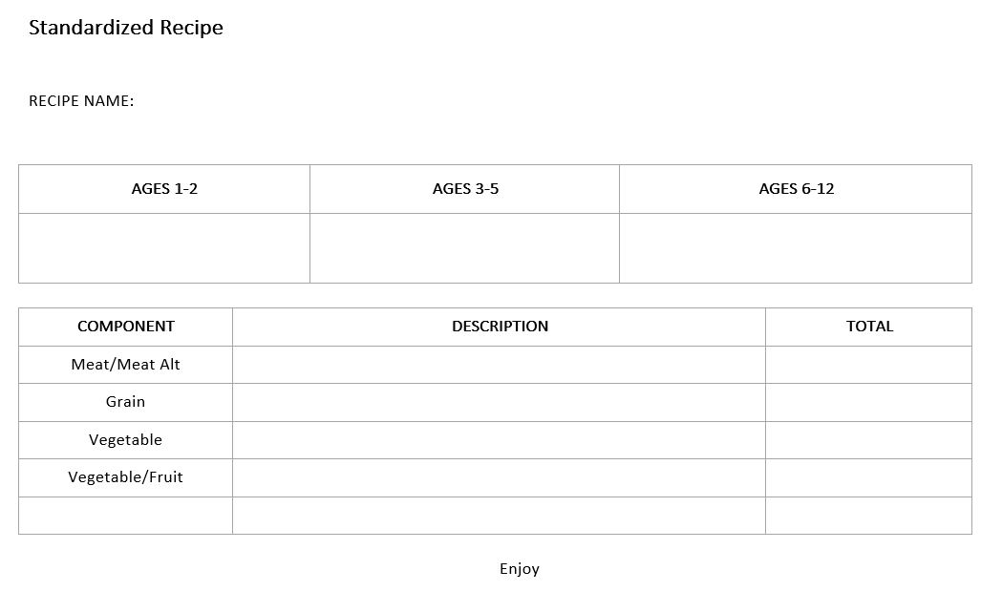
Standardized Recipe Worksheet
*Copies will be mailed out

Slide 5
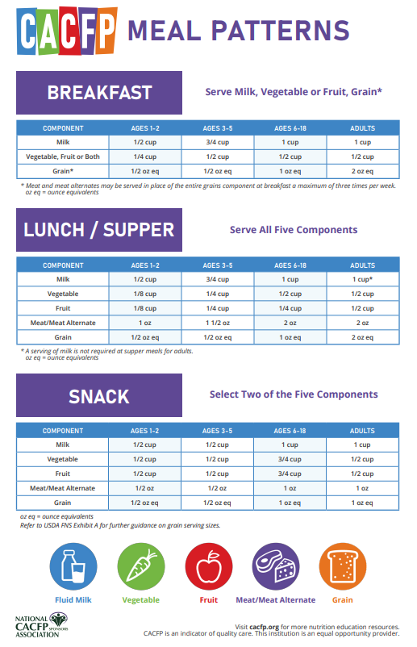
What Will You Need?
Copy of the standardized recipe worksheet
Meal pattern reference sheet

Slide 6
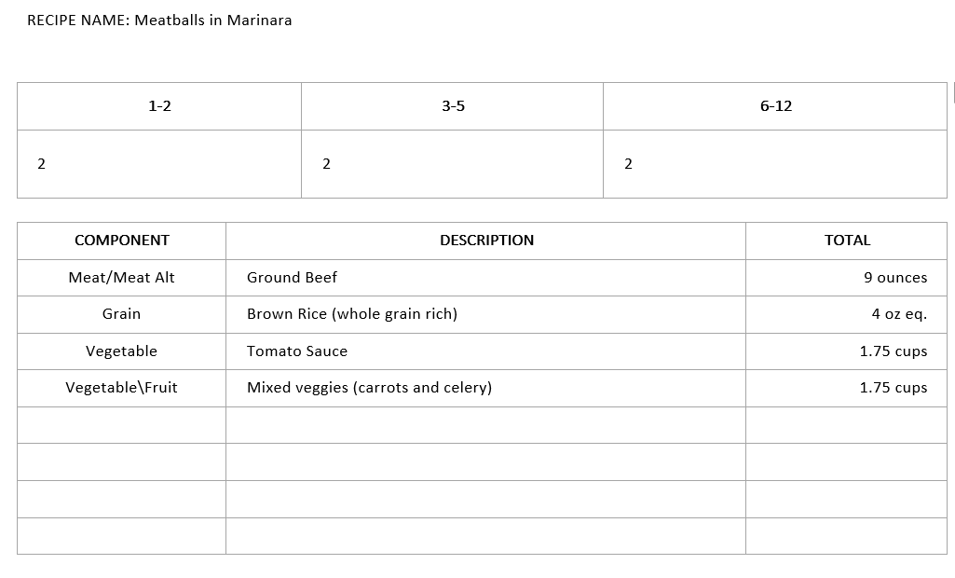
How To Write Your Own Standardized Recipe
Write the name of your recipe.
Write the average number of children you have in a typical week for each age group.
Write the components in the recipe.
To determine the serving size for a component, multiply the age group total by the minimum serving size listed for that age group on the meal pattern worksheet.
After you find the serving size for each age group for one component, add them and it will give you the total serving size for that one component. Write that total in the Total box.

Slide 7
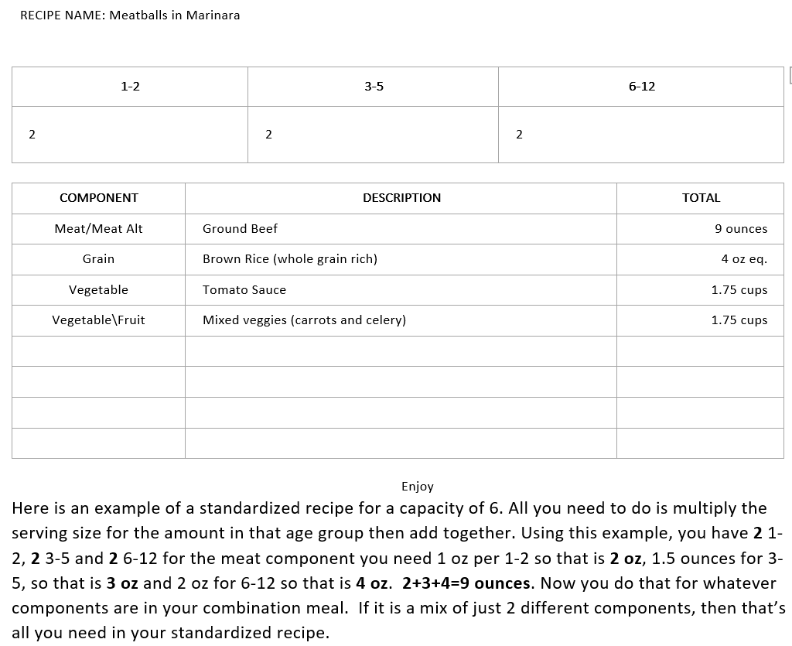
Example 1

Slide 8
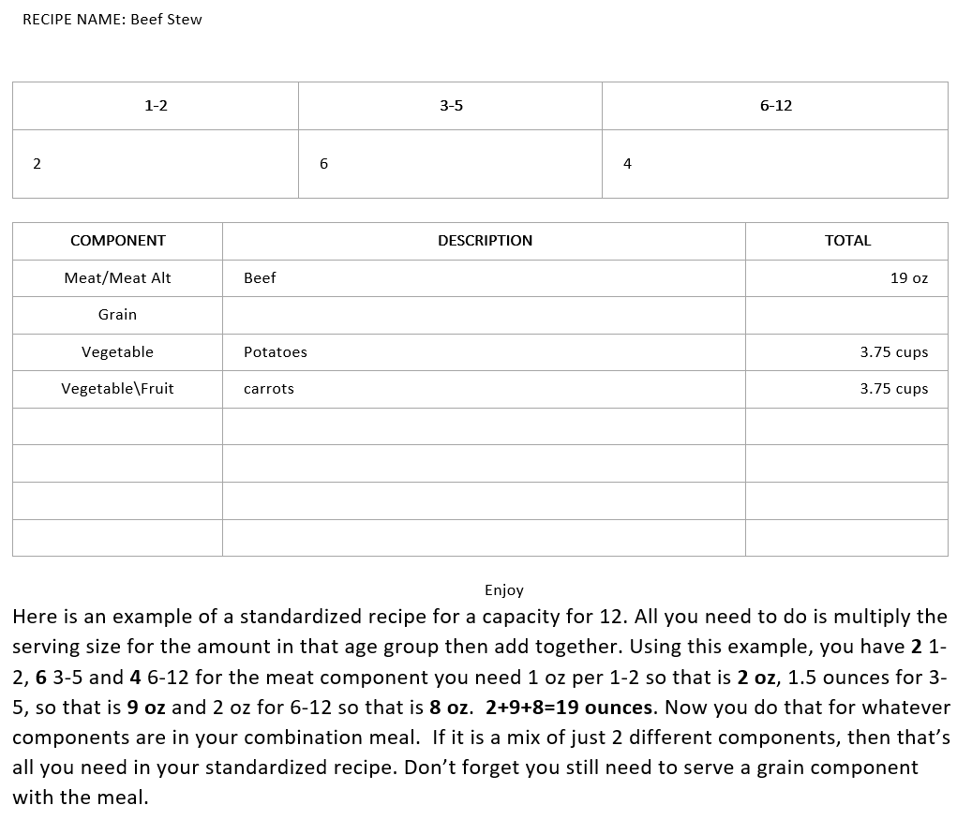
Example 2

Slide 9
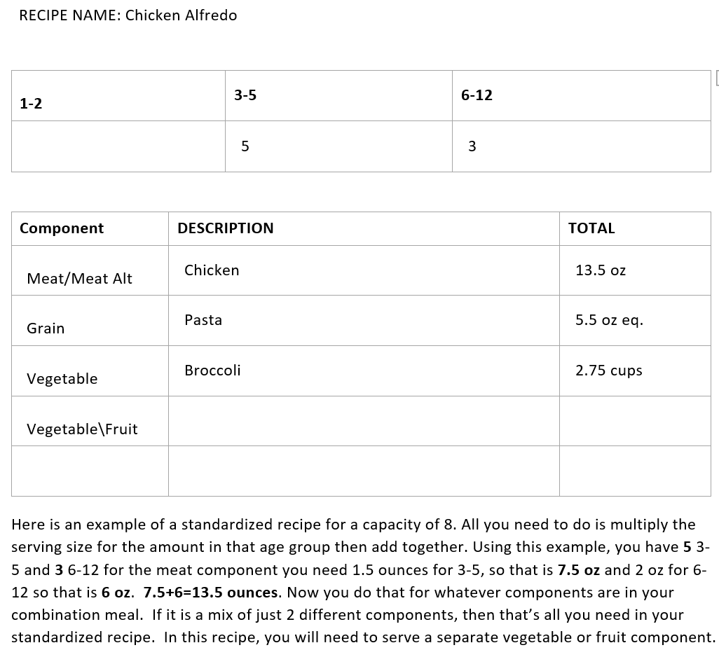
Example 3

Slide 10
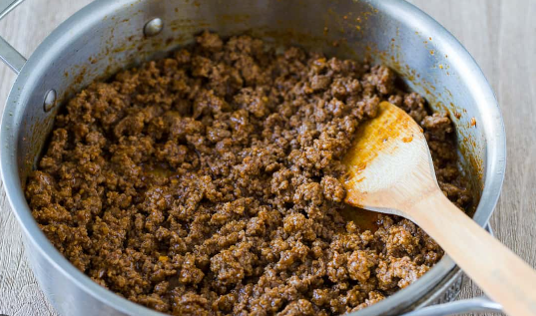
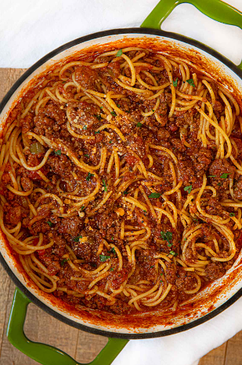
Example: Does Not Require a Recipe-When you serve your kids we are able to see the serving size for each separate component
Example: Requires a Recipe-We have no way of knowing the serving size for each component

Slide 11
What To Expect
We will ask for your standardized recipe during monitor visits if you are serving a homemade dish with 2 or more mixed components.
We will make sure that the totals offer the minimum serving sizes as required by the CACFP.
If you do not want to write standardized recipes, you must not premix your components. As long as the components are separate, a recipe is not required.
Again, we will be mailing out folders with copies of the recipe worksheet and the CACFP meal pattern reference sheet. Please reach out with questions and assistance!!

Slide 12
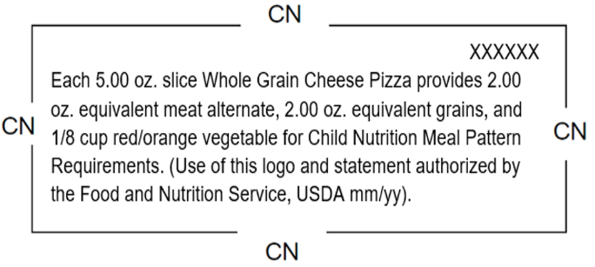
Child Nutrition (CN) Labels
What are CN labels?
CN labels identify the contribution a food product makes towards the child nutrition meal pattern. It is not always possible to know how much meat (or bread) a product provides. A CN label clearly spells out these quantities for a product where there are a mix of ingredients.
Which Foods are Eligible for a CN Label?
CN labels are required for all frozen, pre-packaged (including deli meats) main dish entrees. Examples include beef patties, cheese/meat pizzas, chicken nuggets, corn dogs, fish sticks, meatballs, lasagna, etc.
Where Do I Find CN Labels?
CN labels can be found on the products packaging, near the nutrition label.

Slide 13
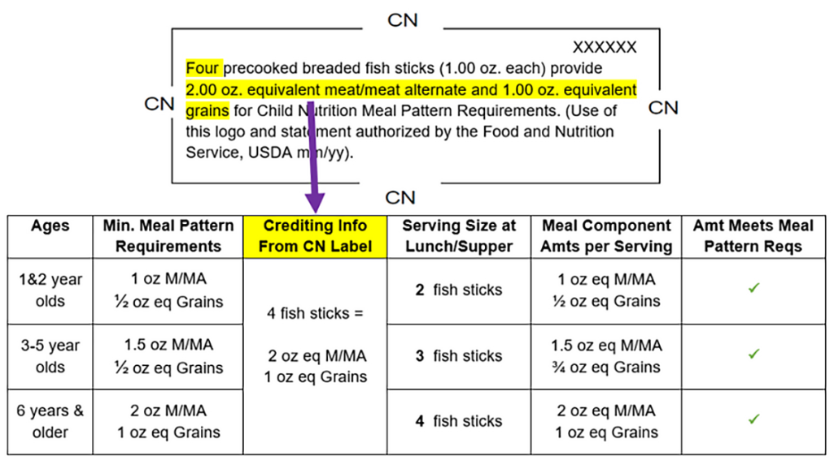
How Do I Use a CN Label?
Compare information from the CN label to the CACFP Meal Pattern minimum requirements to know how much to serve each child.
Do I Have to Keep CN Labels on File?
A CN label must be on available for all processed meats/meat alternates and commercially prepared combination food items. You can keep the original CN label cut from the package or take a photograph.

Slide 14
What If My Product Does Not Have a CN Label?
Option 1 : Serve an additional protein on the side; for example cheese, yogurt, beans, etc.
*When logging in Kidkare use numbers
84 Extra cheese/meat pizza
85 Extra cheese for box macaroni & cheese
14 Extra cheese for chicken nuggets
107 Extra cheese for deli meats
Option 2: Contact the manufacturer or google the Product Formulation Statement. The product formulation statement tells you exact same information as a CN label.

Slide 15
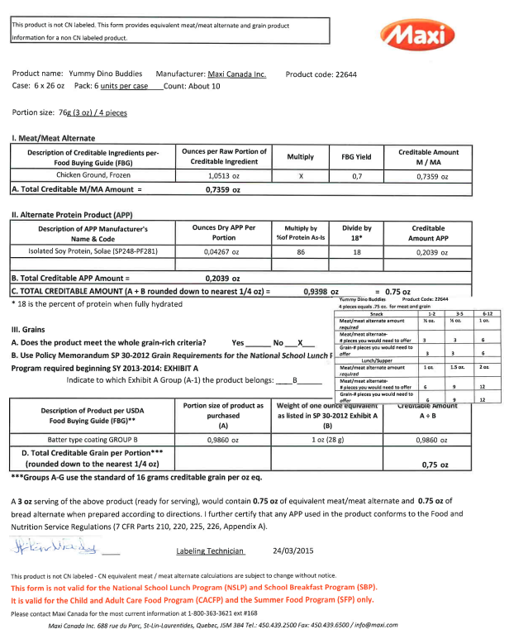
Example: Product Formulation Statement for The Original Yummy Dino Buddies

Slide 16
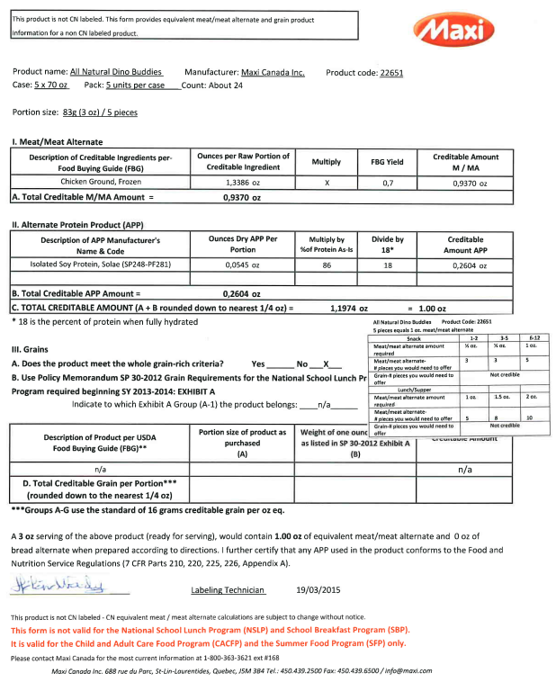
Example: Product Formulation Statement for 100% All Natural Yummy Dino Buddies

Slide 17
Storing Whole Grain Labels
Whole grain labels must be on file and on site. If serving a whole grain rich grain component, you must be able to show us the nutrition label.
Option 1: Cut out the nutrition label and keep in a folder/binder/zip-lock bag
Option 2: Take a picture of the nutrition label and keep a saved file on your phone
You will not be able to claim a grain as whole grain rich at a monitored visit unless the monitor is able to verify the grain as whole grain rich. Please call or email the office with additional questions or clarification.
*We will be sending a folder with protective sheet covers that you can use to store your nutrition labels once you complete annual training

Slide 18
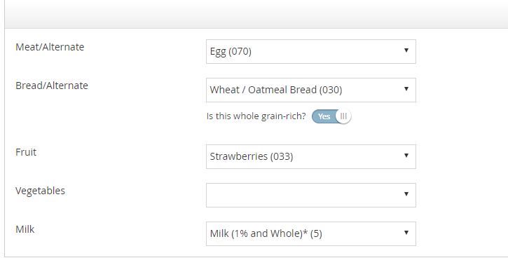
Marking Whole Grains
A Whole Grain Rich Item is required to be served at least once per day in any meal. Please make sure to mark ‘Yes’ if you are serving a whole grain item right under the bread component where it says “Is this whole grain-rich?”
If a whole grain number is being used. The question will automatically be answered.
Whole grain components/numbers are found in the food chart under Whole Grain Bread/Alt section.
You will be disallowed if you do not mark your whole grain! This is the most common error during claim processing

Slide 19
Milk
Organic milk
is allowed
Under 1, iron-fortified infant formula or breastmilk
Age 1-2, whole cow milk
Age 2-5, 1% or fat-free cow milk
Age 6-12, 1% or fat-free cow milk

Slide 20
Milk Alternatives
“Request for fluid milk substitution - child care” form is required to be filled out and signed by the parent for:
8th Continent original soy
Great Value original soy
Kirkland organic soy (plain)
Pacific Ultra soy (plain)
Silk original soy
No other brands of soymilk, or other non-dairy milks, are allowed as substitution with this form.
“Request for fluid milk substitution - child care” form is required to be filled out and signed by the parent for:
Lactose-free milk, any brand
Buttermilk
Goat milk
Kefir milk
Acidified or acidophilus milk
For other milk or food
substitutions a
“Request for Special
Dietary Accommodations”
form must be filled out by
a medical professional

Slide 21
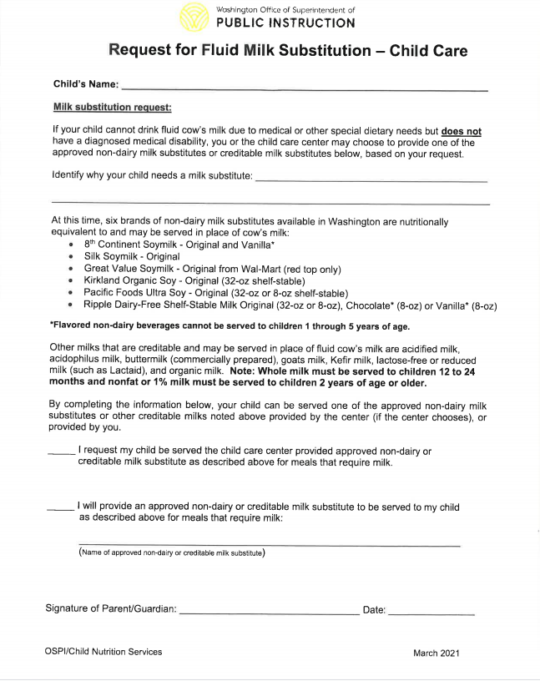
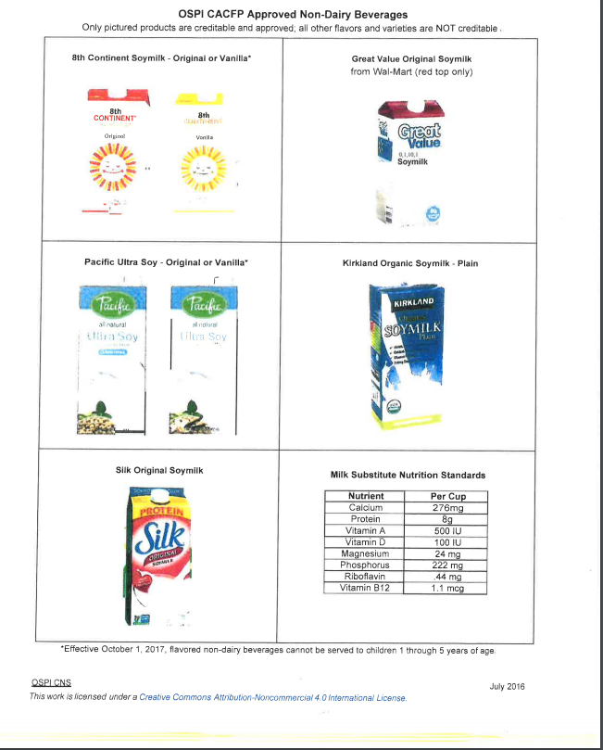

Slide 22
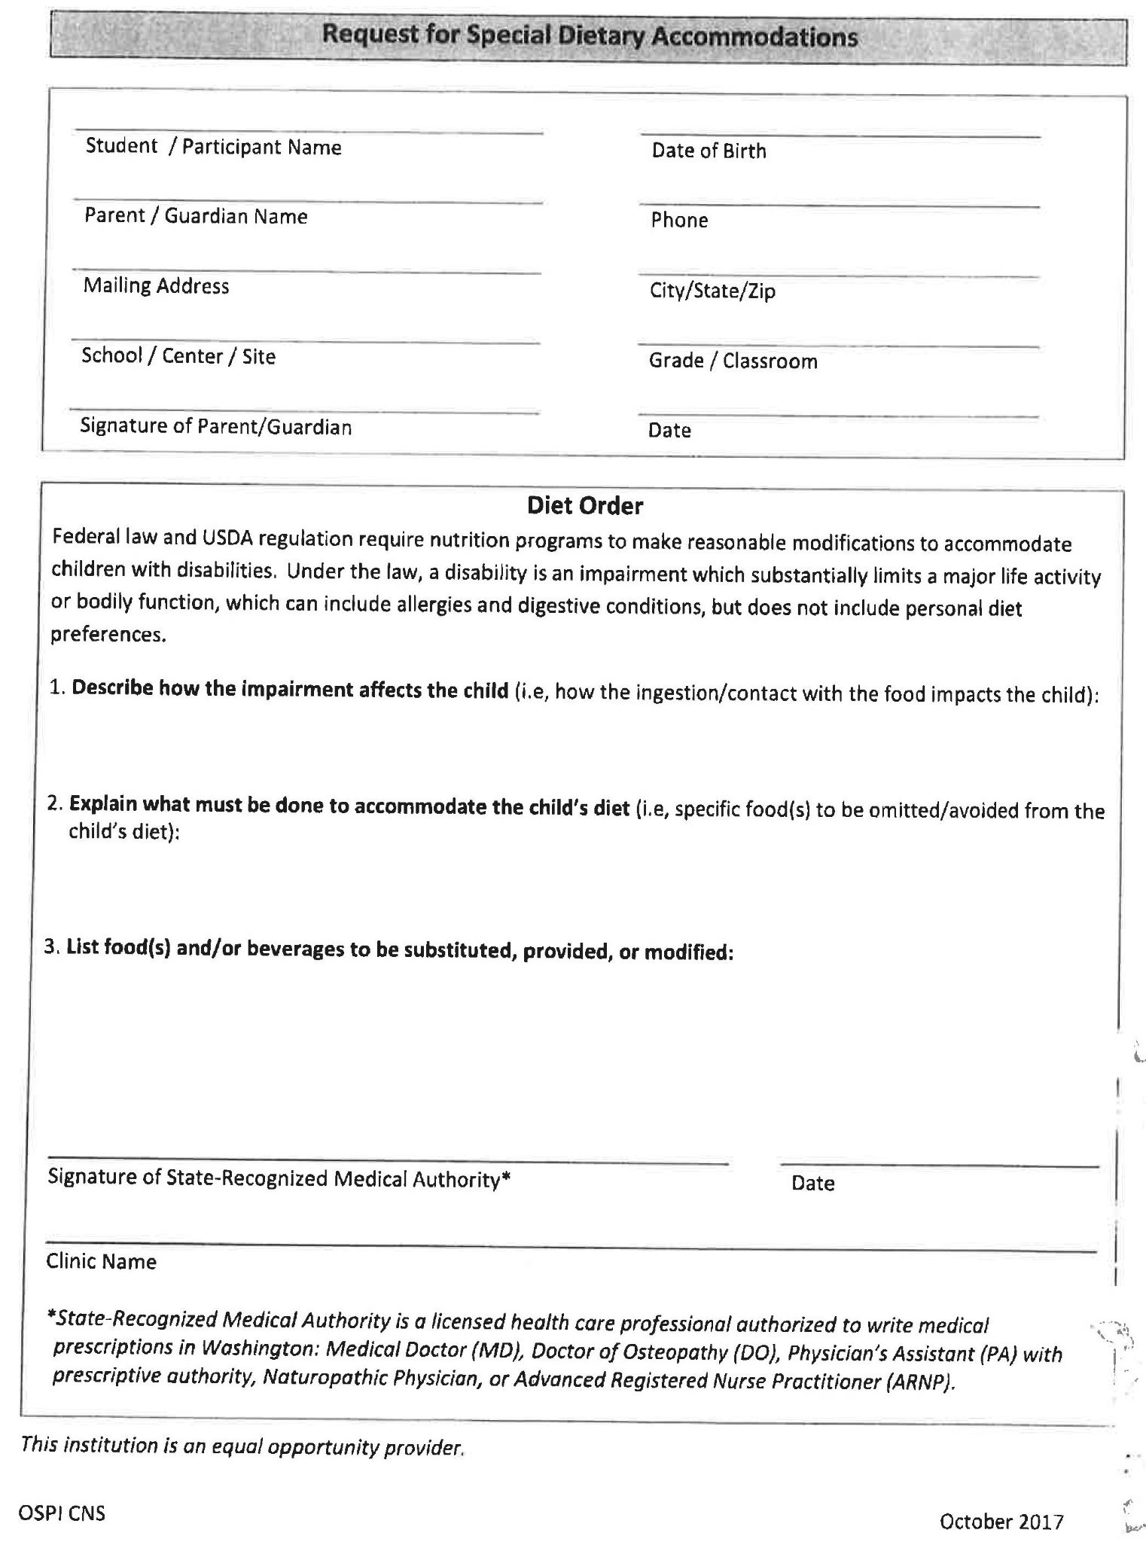
“Request for Special Dietary Accommodations”
Can be used for non-creditable milks, or other menu substitutions
Form must be filled out by a medical professional: MD, DO, PA, ARNP, Naturopath
Must answer all sections
Must specifically say what not to serve, and what to specifically serve as a replacement
CALL OR EMAIL THE OFFICE FOR THE FORM

Slide 23
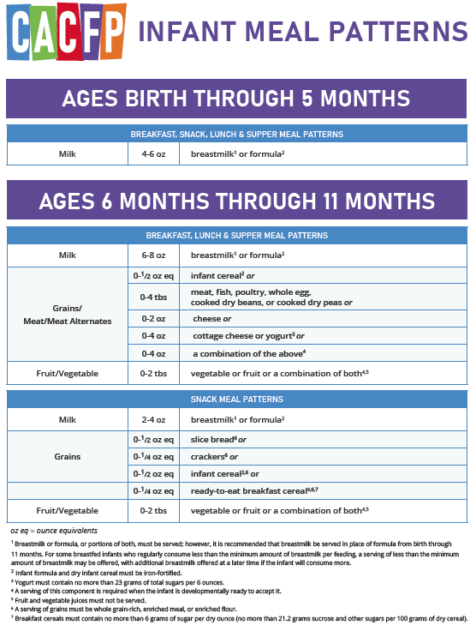
Meal Pattern: Infants
Notes:
https://www.fns.usda.gov/tn/feeding-infants-using-ounce-equivalents-grains-cacfp

Slide 24
Meal Pattern: Infants
Notes:
https://www.fns.usda.gov/tn/feeding-infants-using-ounce-equivalents-grains-cacfp

Slide 25
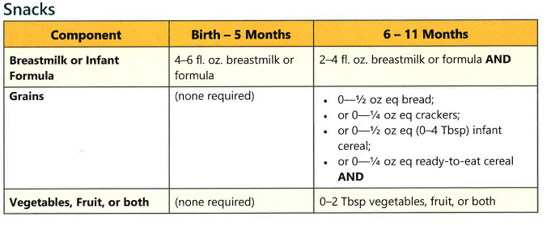

Slide 26
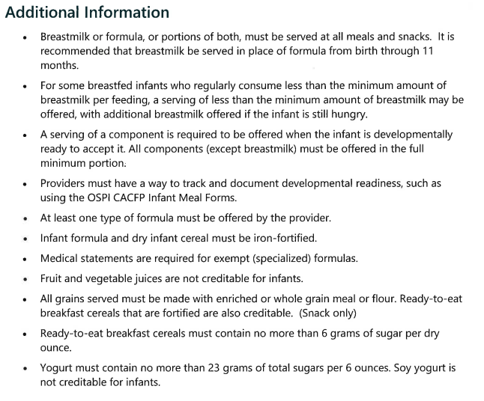

Slide 27
Reminder: Requirements for Enrolled Infants at CACFP Sponsored Centers/Homes
Infants enrolled for care at a participating CACFP center or day care home must be offered a meal that complies with the CACFP infant meal pattern requirements (7 CFR 226.20(b)). CACFP regulations define an enrolled child as “a child whose parent or guardian has submitted to an institution a signed document which indicated that the child is enrolled in child care." A center or day care home may not avoid this obligation by stating that the infant is not “enrolled” in the CACFP, or by citing logistical or cost barriers to offering infant meals.
Sponsors may choose to not claim meals provided to enrolled infants. Regardless if infant meals are claimed, sponsors must offer enrolled infants meals that meet the meal pattern while considering each child’s developmental readiness for meal pattern components. Sponsors must provide food to meet the meal pattern, parents cannot be asked or expected to provide food for their child.
To ensure program compliance, CACFP Specialists will verify that all enrolled infants are provided meals that meet meal pattern requirements during administrative reviews starting in FY23.
Recordkeeping
Infant meal recordkeeping requirements have been revised to alleviate burdensome paperwork in efforts to streamline this process.

Slide 28
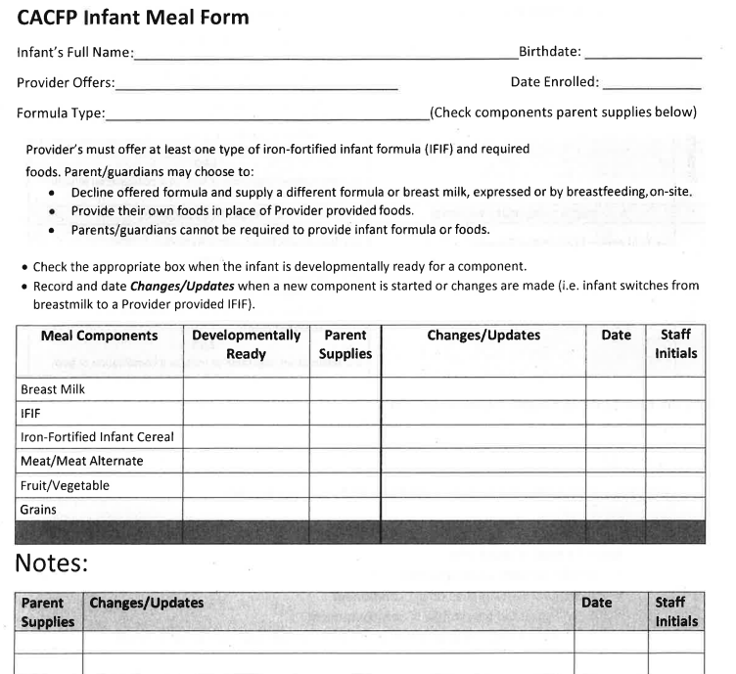
CACFP Required Infant Meal Form

Slide 29
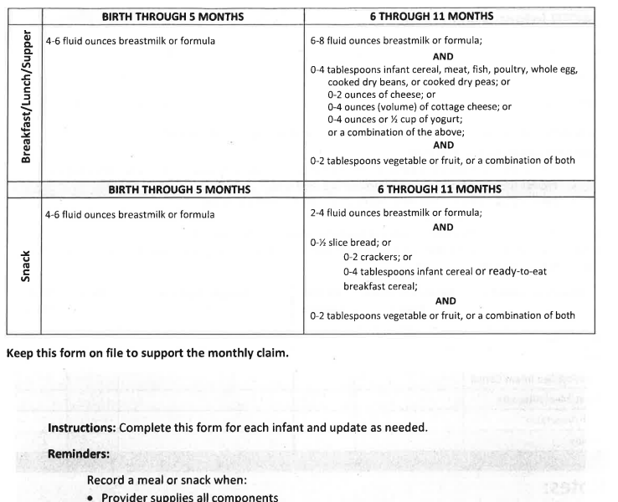

Slide 30
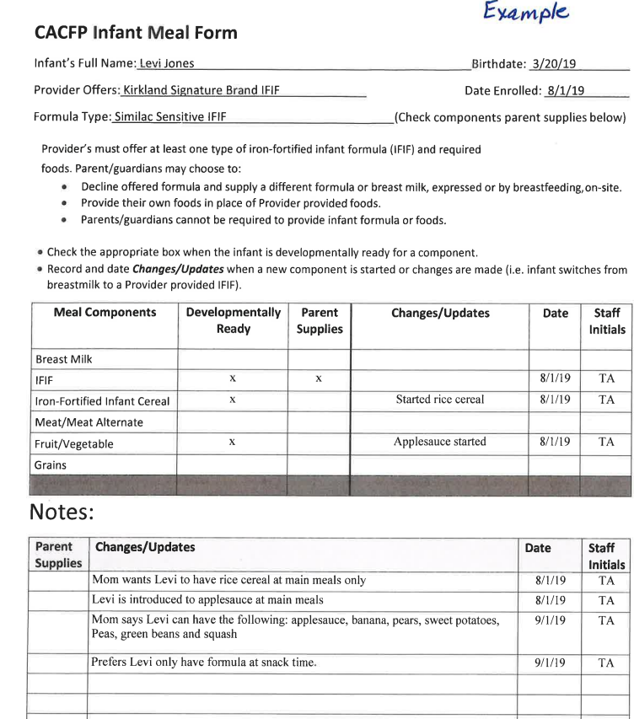
Here is an example of our required infant meal form. You will keep this form for any child you have under the age of 1. Once they turn one you no longer need it. We may ask for this while in your home if we observe any infants.
You will only need to update this form whenever the infant starts eating a new food or if the infant cannot eat certain foods.
Please notify our office if you have any questions and if you need a copy of this form for any infants you may have in care.

Slide 31
Meal Pattern: Age 1-12
Breakfast: Must serve 3 components
Milk, fruit and/or vegetable, and grain (3x out of the week the grain may be replaced by a meat/meat alternate)
Lunch/Dinner: Must serve 5 components
Milk, fruit/vegetable, vegetable, meat/meat alternate, and grain
Snack: Must serve 2 components
Milk, vegetable, fruit, meat/meat alternate, or grain (any combination of two different components)

Slide 32
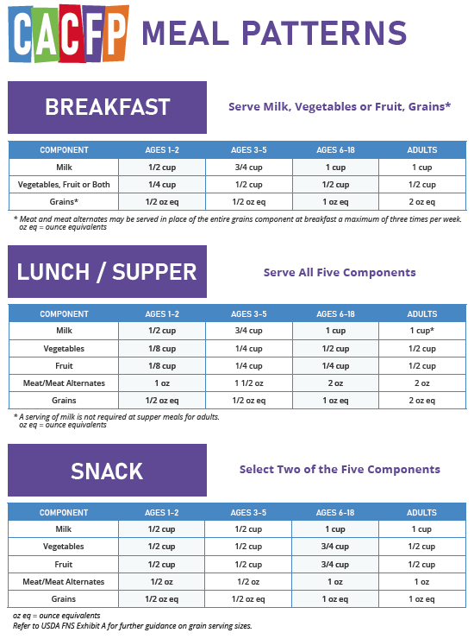
Meal Pattern: Age 1-12
Breakfast must always include a fruit or vegetable. The meat only replaces the grain component.
Grains are measured using ounce equivalents (oz eq). Make sure a whole grain is served and marked at least once per day.
Children age 1-2 must drink whole milk. Children 2 years plus must drink 1%.
Any child who does not drink regular cow milk or has other dietary restrictions needs to have a dietary accommodation form on file with us. Call/email the office so we can send you a copy of the appropriate form needed.

Slide 33
Yearly requirements
Enrollment Forms
Daily Requirements
Claim Submission
Reimbursement Process
Meal Serving Times
Reviews
Deficiencies
New Rates
Income Eligibility Information
Policies
Civil Rights

Slide 34
Enrollment Forms
All children, own and daycare, must be enrolled in the food program.
Once enrolled, print the enrollment form and email a signed copy to: nutrition@catholicharitiescw.org You may also mail a copy to the office. Enrollment forms must be sent to the office within the same month the child started attending or by the 5th of the following month.
Always make sure the parent signature date is within the same month of when the child was enrolled.
Any delay in sending enrollment forms will also delay reimbursement for the meals claimed for that child.

Slide 35
Three Daily Requirements
Daily record keeping is a critical part of participation in the Child and Adult Care Food Program (CACFP). The THREE records that need to be kept on a daily basis are:
Menus – listing each component for all meals served during the day. Menus if handwritten need to be dated for the day the food was served or a written cycle menu may be used if it states by week. Make sure to also mark your whole grain.
Meal Counts – listing each child individually that participated at each meal served, which includes if you are recording in a notebook or by daily worksheets the meals served to each child must be documented.
In and Out Attendance – KidKare software data entry or handwritten attendance forms should be identical to the parent sign in and out attendance records.
Other records that also need to be kept: copies of the Application and Agreement you signed to participate in the program, review forms, child enrollment forms, training certificates etc.
All CACFP records should be kept for the current year, plus 3 years back.

Slide 36
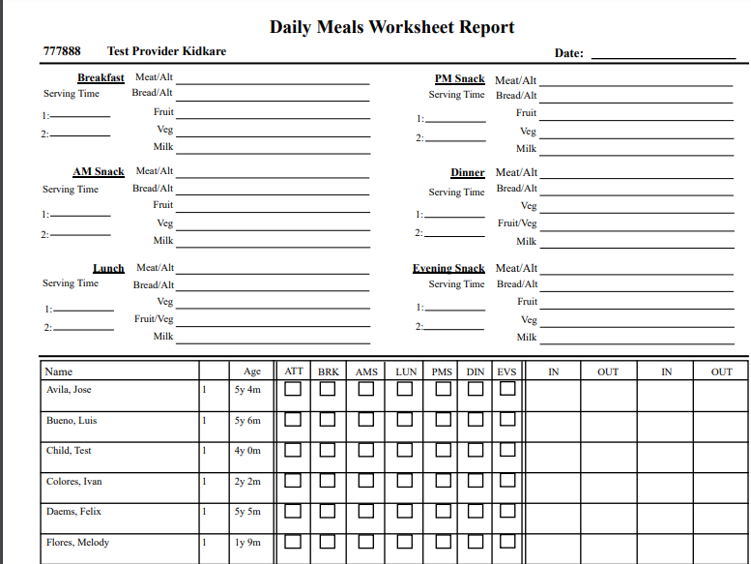
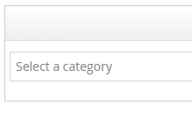
Daily Requirements
Step 1: Reports
If you are unable to log in your daily records in Kidkare, you MUST write them down. Use the daily meal worksheet to keep all of your records organized on one page. You can call the office so we can email you a copy or you can generate your own personalized worksheet in Kidkare.
Step 2: Select a Category
Step 3: Worksheet
Step 4:Daily Meal Worksheet
Step 5: Run

Slide 37
Claim Submission
Submitting your claim by the 5TH OF EACH MONTH assures that you will receive your reimbursement in a timely manner.
Your claim consists of the 3 items listed in record keeping
When you submit your claim, you need to make sure that all supporting documentation is on file to support the claim.
Current Child Care license
Enrollment forms
Holiday Confirmation form signed by each parent (Only for a Major Holiday). Holiday forms must be sent before submitting your claim.
Medical Statement to support special diets (call the office to be sure the correct Medical Statement is used.)
Once your claim is processed an error report will be mailed to each one of you.
PLEASE OPEN YOUR MAIL!
Make sure to read your error report and correct the mistakes you are making.

Slide 38
Reimbursement Process
Meals will be reimbursed to the provider within five working days after Catholic Charities Care Nutrition Program (CACFP) receives payment from (OSPI). Payments are issued on the last working day of each month.
Meals will be reimbursed for the appropriate number of meals multiplied by the current reimbursement rate set by USDA.
Meals may be disallowed for reimbursement if:
The provider records are incomplete, inaccurate or missing
Meals that do not meet the CACFP meal pattern requirements
Meals are claimed in excess of the authorized licensed capacity
Meals that do not match with the monitor during a review

Slide 39
MEAL SERVING TIMES

Slide 40
BREAKFAST
Serving Time
6:00 AM - 9:00 AM
The children must be in the door by 8:55 AM in order to claim breakfast. We have the breakfast time set in our system to continue on for 3 hours so that it will meet the needs of the children coming in at different times in the morning.
Providers need to make sure the serving time listed is the first time a child is served. If you list a later meal time, and some of the children have already ate and left for school, the system doesn’t think they were in your care during the meal service.

Slide 41
AM SNACK
Serving Time
9:00 AM -10:45 AM
The child must be present for at least 5 minutes. There are no restrictions for AM Snack, it is the providers choice to serve it or not. Keep in mind that the children shouldn't go more than 3 hours in between meals.

Slide 42
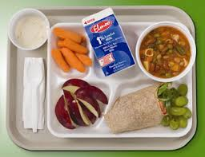
LUNCH
Serving Time
10:45 AM– 1:30 PM
Lunch time cannot begin before 10:45 am unless we have a note on file from a school official that states the children have to be picked up early to meet their bus schedule.
The children must be in the door no later than 1:25 pm in order to claim the lunch.
The children must be in care at the least 10 minutes in order to claim the lunch.

Slide 43
PM SNACK
Serving Time
2:00PM – 4:45 PM
The children must be in care for at least 5 minutes in order to claim afternoon snack. They must eat the snack on your premises. You cannot fill up a baggie for them to take with them if they leave.

Slide 44
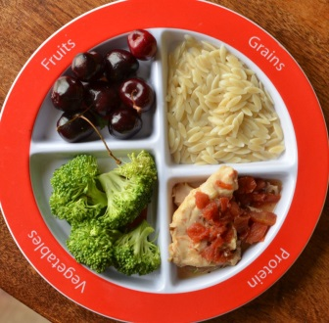
DINNER
SERVING TIME
5:00PM - 7:00PM
Dinner CANNOT start before 5:00 pm and the children must be in your care for at least 10 minutes from the start of dinner. If they leave before 5:10 pm, the meal will be disallowed. Dinner ends at 7:00 pm and cannot be claimed for children arriving at 7:00 pm or later.

Slide 45
Evening Snack
Serving Time
7:00 PM – Bedtime
Evening Snack cannot start before 7:00 pm, so if the children leave before 7:00 pm the snack will be disallowed.

Slide 46
REVIEWS:
Catholic Charities Child Care Nutrition is required by USDA to conduct at the least 3 reviews with providers within our fiscal year. Our fiscal year starts October 1st thru September 30th. We must observe at least one main meal and a snack . Two out of the three visits must be unannounced. Reviews may be conducted between 2 and 5 months, not to exceed 6 months. Extra unannounced visits may be required if a provider is claiming dinners and/or weekends. You may not always have the same person conducting your review, so please welcome all Review Specialist’s into your home. We all have ID badges.***
DINNER REVIEW:
If a Provider is claiming dinners on a regular basis a review must be conducted for the meal. Providers are required to let the office know if they are not serving dinner on a regular night that they usually serve and claim. If we attempt two dinner visits and the Provider is not home or is not serving and has not informed the office, the Provider will receive a letter stating dinners will be revoked for 6 months.***

Slide 47
WEEKEND REVIEW:
If a Provider is claiming weekends on a regular basis (at least 2 weekends in a month), a review must be conducted. The same rules apply as with dinners. The Provider will receive a letter stating that claiming meals on weekends will be revoked for 6 months if we attempt 2 visits.
Additional Reviews may be needed depending on the hours and meals a Provider is claiming or because of a deficiency.
You may contact the office for closure times or schedule changes by:
Phone: (509) 965-7107 make sure you leave a message if no answer or we are closed.
Email: nutrition@catholiccharitiescw.org
Closed Dates: In Kidkare go to Calendar. Select date, drag and drop the closed box.
School Child Information: In Kidkare, when a child is present during AM or Lunch make sure to click these 3 lines which will give you the option to choose Sick, No School or Present during Holiday

Slide 48
USDA is adamant that Providers will follow the rules and regulations of the CACFP. Our Food Program Specialist’s are required to report any deficiency for not following the rules and regulations of the Program. In past years we had several Providers that were Serious Deficient, several that were Propose to term and a few Providers that were disqualified for repeated offense. This years percentage is higher than it has been in over 10 years.
PLEASE MAKE SURE YOU’RE KEEPING UP WITH ALL PROGRAM REQUIREMENTS
1.1 to 2 days behind RECORDING YOUR MEALS. The meals will be deducted and the days will be noted in your file.
2. 3 days or more behind RECORDING YOUR MEALS you will go straight to Serious Deficiency, a letter will be sent to you by certified mail. You must then write out a plan to keep your records up to date and always abide by that plan. You can not get behind again within a 2 year period and if you are, a letter of Propose to Termination and Disqualification from the Program will follow.
This is the most common reason for deficiencies.

Slide 49
Meal doesn’t match the foods that were observed during a review. T/A will be given and meal disallowed.
Children claimed doesn’t match the children that were in care or observed during a review. T/A will be given and child/children will be disallowed.
Claiming children that are no longer in care. Serious Deficiency letter will be sent.
Not serving 1% or non-fat milk. T/A will be given and meal disallowed.
Not serving all the required components with the correct portion size. T/A will be given and meal will be disallowed.
Not home during regular business hours and office not informed. T/A will be given and meal will be disallowed if during a mealtime.
These are the most common reasons, although there are too many to be able to list.
PLEASE ALWAYS KEEP YOUR RECORDS UP TO DATE, WE DO NOT ENJOY TAKING MEALS AWAY FROM PROVIDERS.

Slide 50
New Meal Rates July 1, 2023-June 30, 2024
TIER 1 Rates
Breakfast $1.65
Lunch\Dinner $3.12
Snack $.93
TIER 2 Rates
Breakfast $.59
Lunch\Dinner $1.88
Snacks $.25
You will be reimbursed either 2 main meals and 1 snack or 2 snacks and 1 main meal.
You still need to be income eligible to claim your own children (or any child residing in the daycare home). If you have not been eligible to claim your own in the past please reach out and we can check again for you.

Slide 51
Income Eligibilities
Income Eligibilities are distributed once a year for Providers who wish to claim their own children’s meals, or for providers trying to qualify for Tier 1 rates. Income statements must be returned by the last day of the month in which the new statement was issued.
Please see the next slide for the new guidelines for income as of July 1st, 2023. If you think you may qualify to claim your own children’s meals, please call the office and we will send you the form.

Slide 52
INCOME-ELIGIBILITY GUIDELINES
REDUCED-PRICE MEALS
Effective July 1, 2023–June 30, 2024
Household Size | Annual | Monthly | Twice Per Month | Every Two Weeks | Weekly
1 | $26,973 | $2,248 | $1,124 | $1,038 | $519
2 | $36,482 | $3,041 | $1,521 | $1,404 | $702
3 | $45,991 | $3,833 | $1,917 | $1,769 | $885
4 | $55,500 | $4,625 | $2,323 | $2,135 | $1,068
5 | $65,009 | $5,418 | $2,709 | $2,501 | $1,251
6 | $74,518 | $6,210 | $3,105 | $2,867 | $1,434
7 | $84,027 | $7,003 | $3,502 | $3,232 | $1,616
8 | $93,536 | $7,795 | $3,898 | $3,598 | $1,799
For each add’l family member, add: | $9,509 | $793 | $397 | $366 | $183

Slide 53
Household Size Changes
Any children under the age of 13 years living in your home must be considered your own (whether they are biologically yours or not)
Example: Grandchildren moved in; nieces and nephews moved in etc.
In order to claim the children who live in your home, you must be income eligible. Please note: whether you are eligible to claim them or not, you must still include them on your daily attendance!!
Call the office to notify us about new children residing in your home.

Slide 54
Policies
Propose to Terminate Policy
Appeal Procedure
Transfer Policy

Slide 55
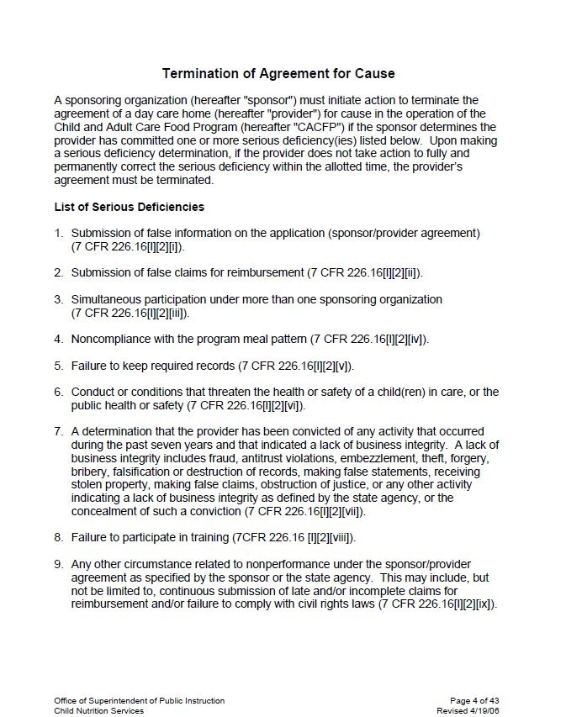
Termination Policy

Slide 56
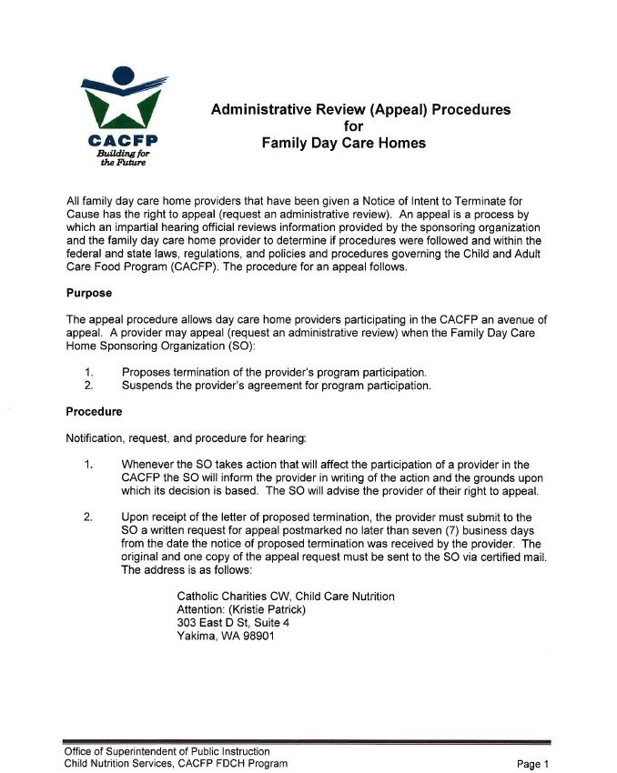
Appeal Procedure Policy

Slide 57
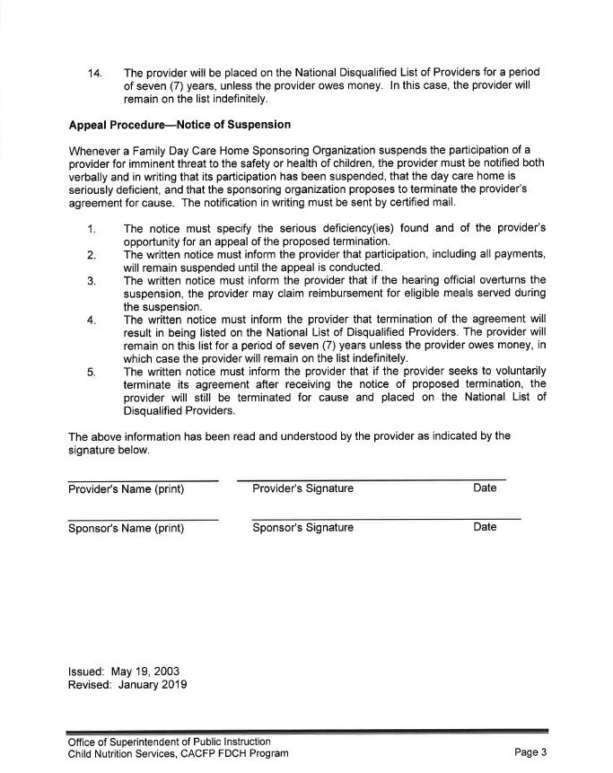

Slide 58
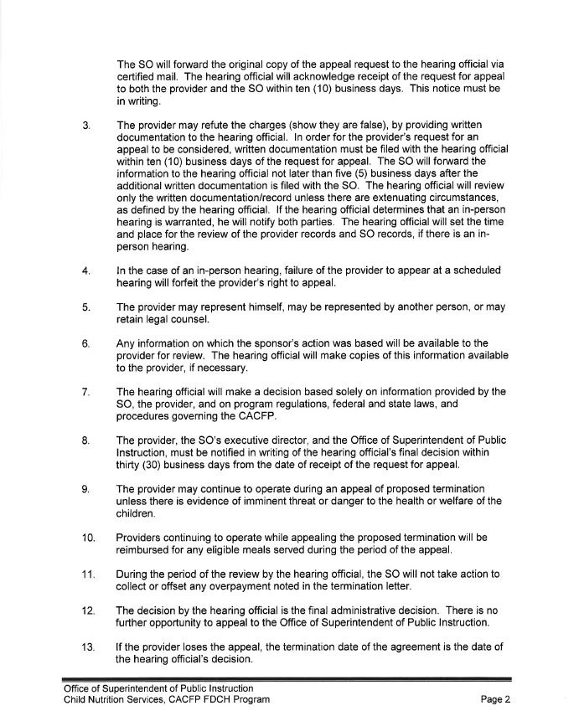

Slide 59
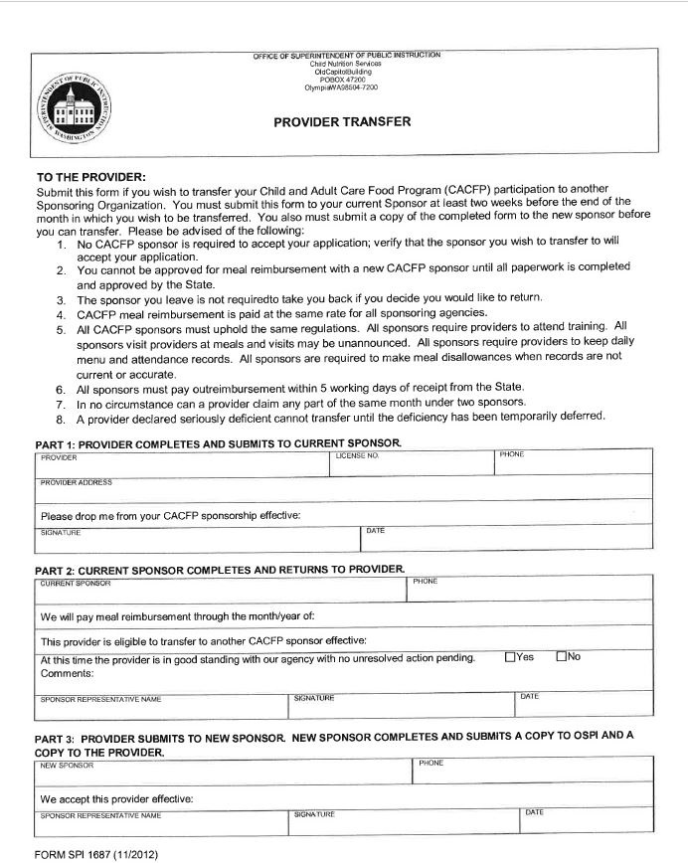
Transfer Policy

Slide 60
Catholic Charities Civil Rights Policy
Catholic Charities Child Care Nutrition Program and it’s employees will ensure every customer will be treated fairly, equally, with dignity and respect. There will be no exceptions or excuses.
We have a moral and legal obligation to treat our customers with respect and courtesy, regardless of race, color, national origin, gender, religion, age, disability, political belief, sexual orientation, marital or family status. All employees of Catholic Charities Child Care Nutrition Program must commit to uphold this policy.
Our board of Directors and Executive Director will comply with, or adopt USDA’s civil rights policy at Catholic Charities Child Care Nutrition Program. Refusal of any kind against customers will not be tolerated; each of us must demonstrate a commitment to equal treatment for all individuals.
Any and all complaints should be forwarded to the Executive Director and/or the USDA. A complaint form will be filled out at the time of the complaint (by the Executive Director or customer with complaint). A copy of the complaint form will be forwarded to the U.S. Department of Agriculture and the Office of the Superintendent of Public Instruction.
An internal discussion will take place with the Board of Directors, employee and Executive Director to allow the employee in question to give his/her version of the reported incident to the Board. The Board of Directors will have the final decision of disciplinary action for the employee, if found to be in the wrong.

Slide 61
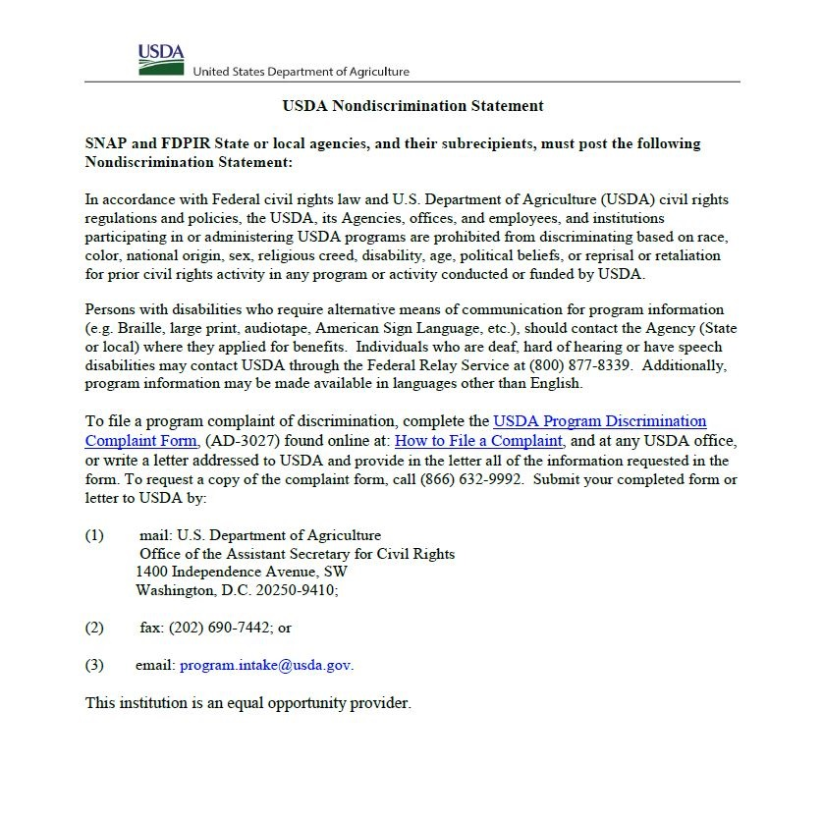
Civil Rights
Catholic Charities Child Care Nutrition program providers will be treated fairly, no exceptions
The Civil Rights Policy will be adopted by the Board of Directors
Complaints against employees will be addressed and resolved

Slide 62
In accordance with federal civil rights law and U.S. Department of Agriculture (USDA) civil rights regulations and policies, this institution is prohibited from discriminating on the basis of race, color, national origin, sex (including gender identity and sexual orientation), disability, age, or reprisal or retaliation for prior civil rights activity.
Program information may be made available in languages other than English. Persons with disabilities who require alternative means of communication to obtain program information (e.g., Braille, large print, audiotape, American Sign Language), should contact the responsible state or local agency that administers the program or USDA’s TARGET Center at (202) 720-2600 (voice and TTY) or contact USDA through the Federal Relay Service at (800) 877-8339.
To file a program discrimination complaint, a Complainant should complete a Form AD-3027, USDA Program Discrimination Complaint Form which can be obtained online at: https://www.usda.gov/sites/default/files/documents/USDA-OASCR%20P-Complaint-Form-0508-0002-508-11-28-17Fax2Mail.pdf, from any USDA office, by calling (866) 632-9992, or by writing a letter addressed to USDA. The letter must contain the complainant’s name, address, telephone number, and a written description of the alleged discriminatory action in sufficient detail to inform the Assistant Secretary for Civil Rights (ASCR) about the nature and date of an alleged civil rights violation. The completed AD-3027 form or letter must be submitted to USDA by:
mail: U.S. Department of Agriculture Office of the Assistant Secretary for Civil Rights 1400 Independence Avenue, SW Washington, D.C. 20250-9410; or
fax: (833) 256-1665 or (202) 690-7442; or
email: Program.Intake@usda.gov
Nondiscrimination Statement

Slide 63
Things you need to know!!
If you have been issued a waiver, and you haven’t sent it to us yet, please do so. We need it to ensure that we are not taking away your extra children. We just want to make sure you are getting the correct reimbursement.
If you have had any changes to your license please send us a copy.
At this time the best way to reach us is by email. Nutrition@catholiccharitiescw.org

Slide 64
Extra
Notify the office by email if you are closed, on vacation, or inactive.
Make sure you are notifying us of all school changes. If things change we need you all to be contacting us to so we can keep things updated.
Make sure you are serving a Whole Grain Rich Item daily. Providers must click on the Yes/No question ( is this whole grain-rich) according meal.
Verify in/outs before submitting your claim.
Things look a little different this year, but the end result is the same. Keeping children fed, happy and healthy!! Thank you all for all you do to ensure this!!!!

Slide 65
Thank you for participating in our yearly training!
Please complete the Quiz Form
Submit the forms online or mail them to our office.
This is your documentation that you completed the mandatory training for the food program compliance.
Make sure you complete the training no later than September 25th, 2023.
The quiz is your time stamp. You must answer all the questions or it won’t submit.
Thank you for another great year!!!

